Slide 1
Rare event detection
Kevin Chang

Slide 2
Outline
Data Analysis Summary & Cleanup procedure
Inputaion
Transformation
Model proposals & Result
Conclusion

Slide 3
Data Analysis Summary & Cleanup procedure
Attribute #5 in training set and testing set are not consistent
Attribute #6 corresponds to the boolean value of attribute #4
Standard deviation of attribute #166,167,168,170,171,172,177 in training set are zero
Some testing samples have missing data or target (attribute #4) label

Slide 4
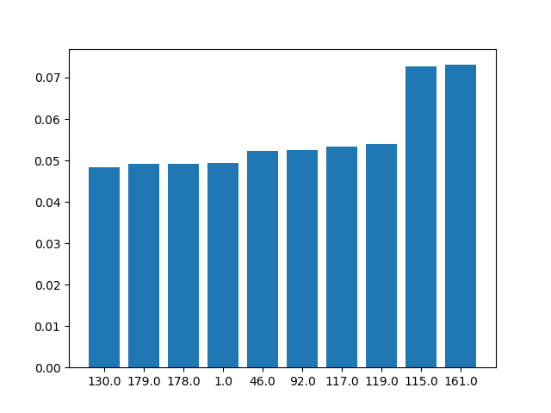
Inputation
Sample #3 in training set have missing attribute #7
Use regression method to predict its value and fill it in

Slide 5
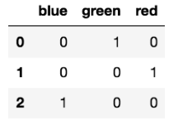
Transformation
Some attributes are in the form of TRUE/FALSE or category
=> Use one hot encoding
Standardize each attribute, and record its mean and standard deviaton for forecasting
https://medium.com/@yehjames/%E8%B3%87%E6%96%99%E5%88%86%E6%9E%90-%E6%A9%9F%E5%99%A8%E5%AD%B8%E7%BF%92-%E7%AC%AC2-4%E8%AC%9B-%E8%B3%87%E6%96%99%E5%89%8D%E8%99%95%E7%90%86-missing-data-one-hot-encoding-feature-scaling-3b70a7839b4a

Slide 6
Model proposals & Result
Deep neural network (DNN)
DNN + over/down sampling
DNN + Generated synthetic samples
Support vector machine (SVM) + Generated synthetic samples
Logistic regression + Generated synthetic samples

Slide 7
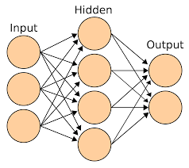
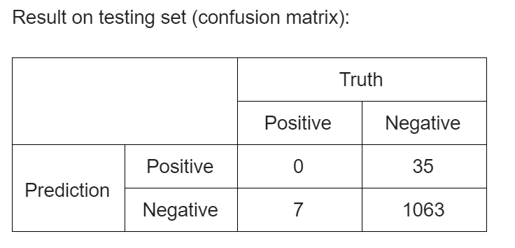
Deep neural network (DNN)
Optimizer : Adam
Loss function : Binary cross entropy
Activation function : Relu
Introduce dropout layer to avoid overfitting
Adjust the weight of BCE loss function

Slide 8
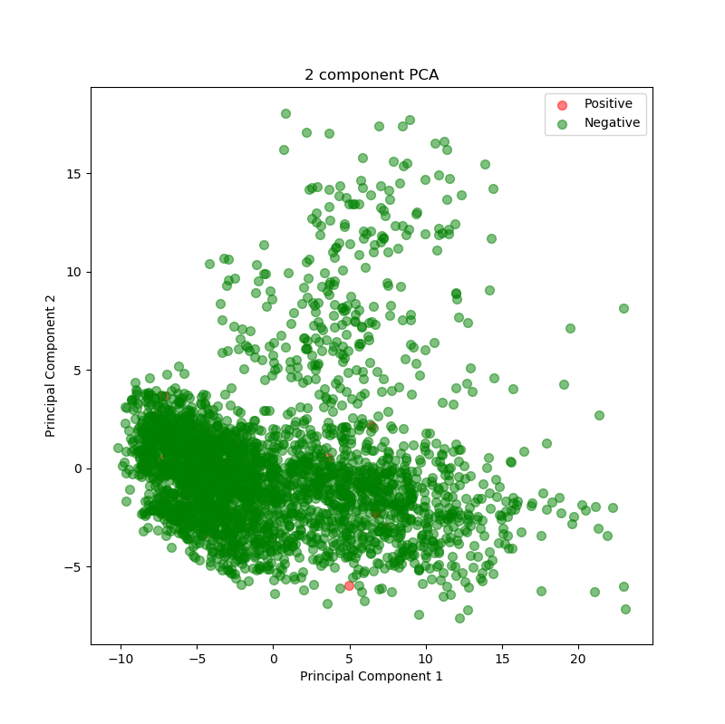
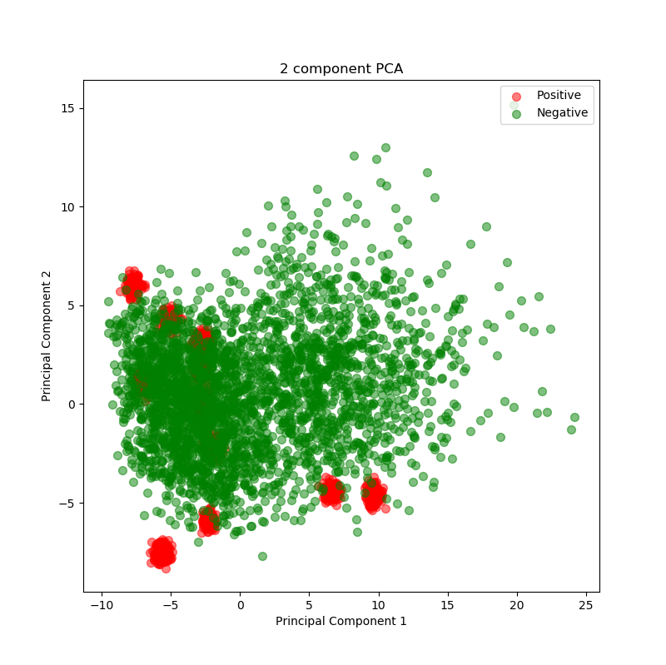
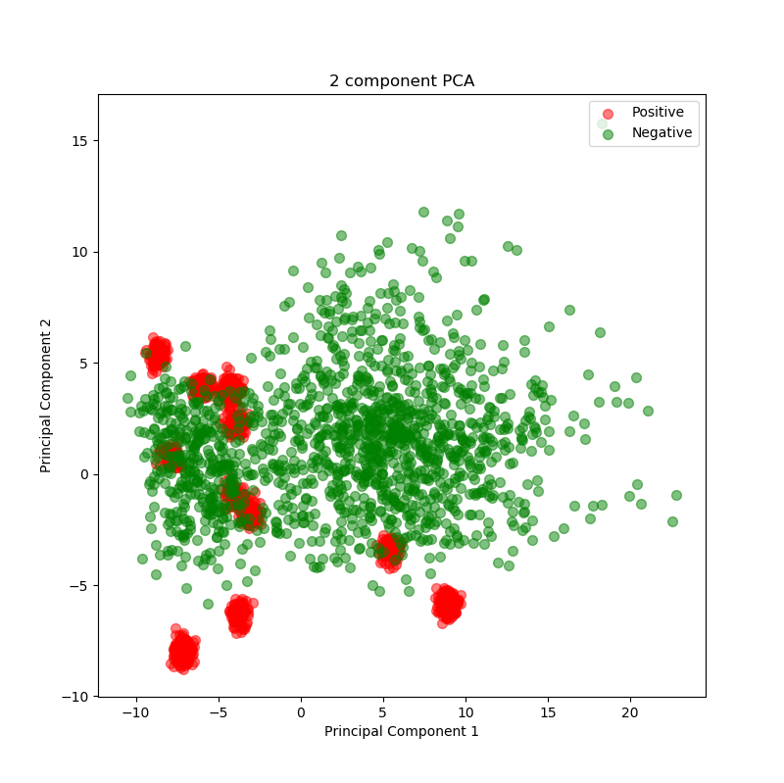
DNN + over/down sampling
Imbalanced dataset
Oversampling : Copying them and adding small noise (avoid overfitting)
Downsampling : Deleting some negative samples for balance

Slide 9
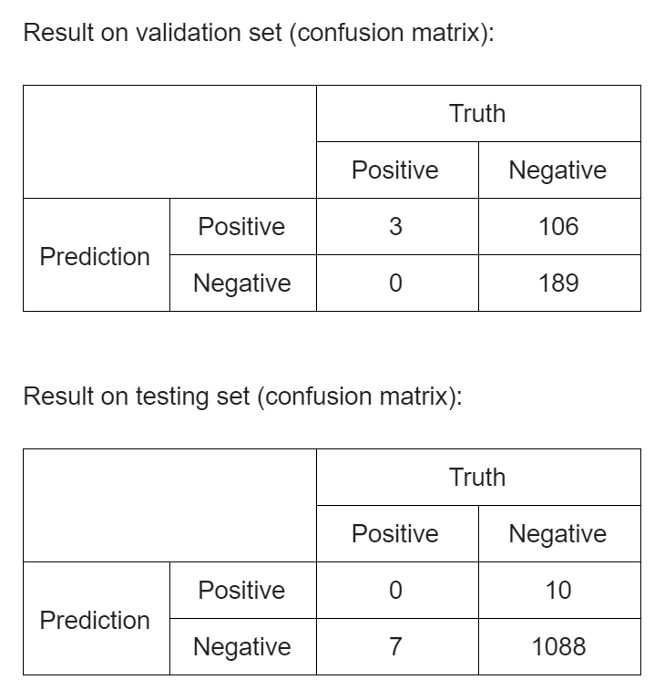
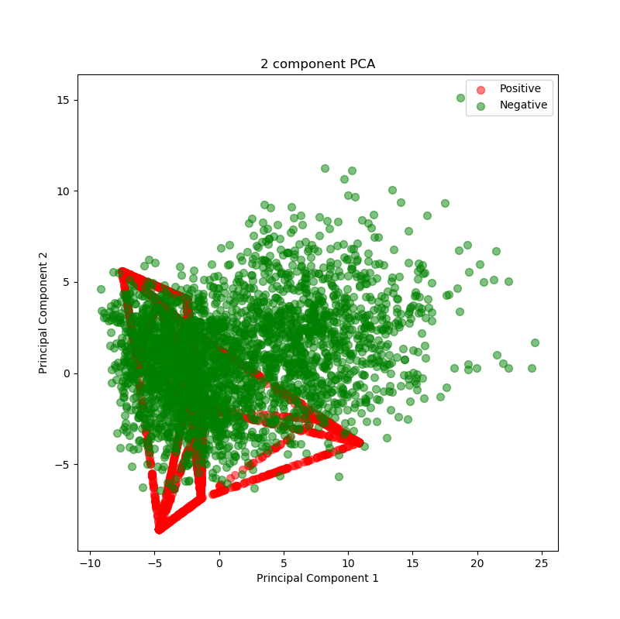
DNN + Generated synthetic samples
SMOTE Introduces randomness in generating the synthetic data
Interpolation with neighbors

Slide 10
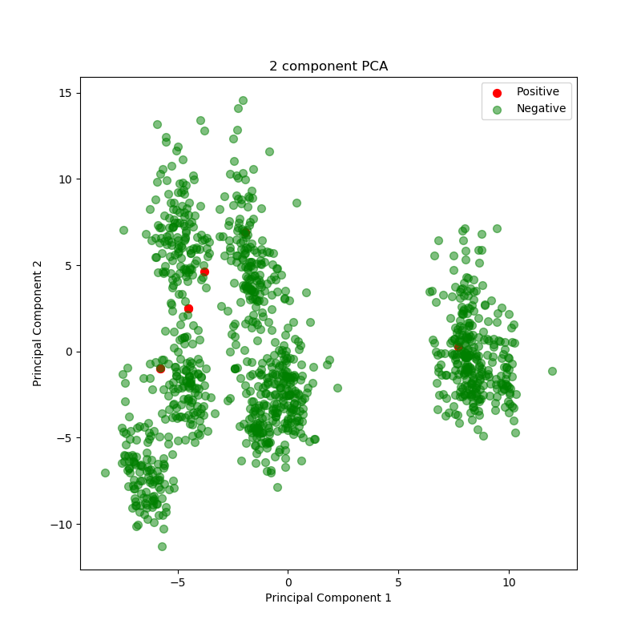
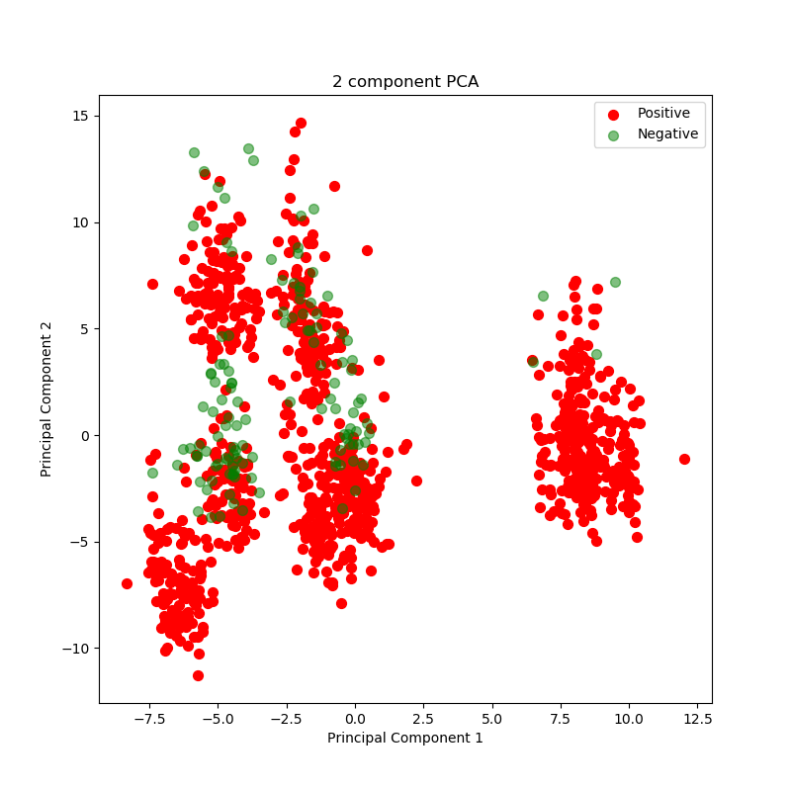
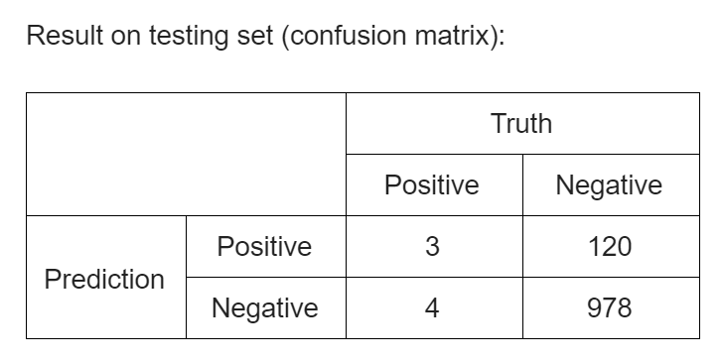
SVM + Generated synthetic samples
Hinge loss function
Kernal trick
Non-linear binary classification

Slide 11
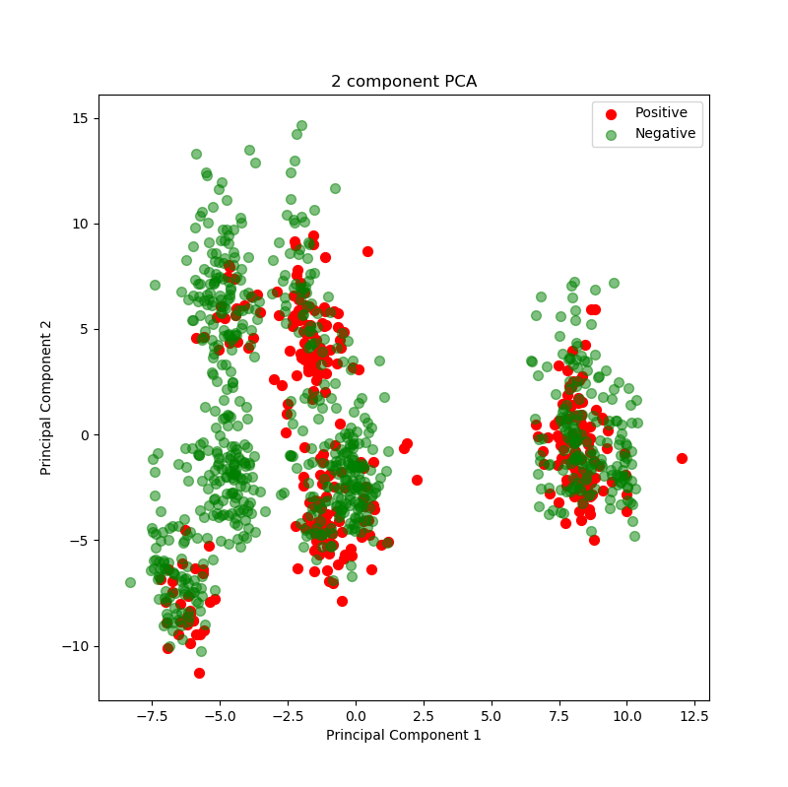
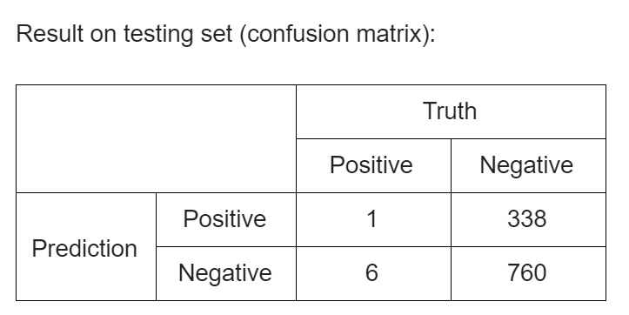
Logistic regression + Generated synthetic samples
Cross entropy between two Bernoulli distribution
Gradient descent

Slide 12
Conclusion
Neural-based method can learn to detect rare event, but performs poorly on testing set due to overfitting, so does non neural-based approaches
Over/down sampling and SMOTE algorithm to balance the dataset are not significant
More balanced dataset and customized methods are necessary to tackle this kind of rare event detection

Slide 13
Thanks for listening !

